Slide 2

Questions
Retrive the total number of orders placed
Calculate total revenew generated from pizza sales
Identify heighest price pizza 4.Identify the most common
pizza size ordered
5.List the top 5 most ordered
pizzas along with their quantity

Slide 3
Questions
Join the necessary table to find the total quantity of each pizza category ordered
Determine the distribution of orders by hour of the day
Join the relevent table to find the category-wise distribution of pizzas
Determine the 3 most ordered pizza based on the revenue

Slide 4
10. Group the orders by date and caliculate the avarage number of
Questions
pizzas ordered per day 11.Calculate the percentage
contribution of each pizza type to total revenue
Analyze the cumulative revenue
generated over time
determine the top 3 most ordered pizza types based on revenue for each pizza category

Slide 5






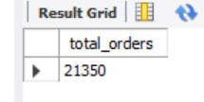

1.Retrive the total number of orders placed

Slide 6


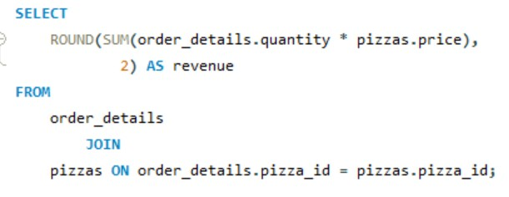
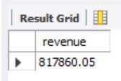

2.Calculate total revenew generated from pizza sales

Slide 7
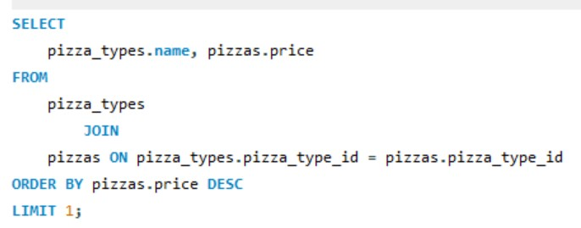

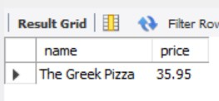
3.Identify heighest price pizza

Slide 8


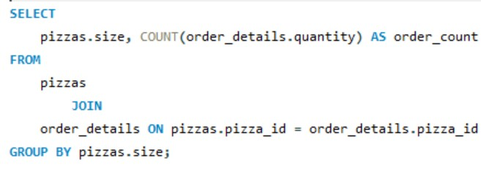
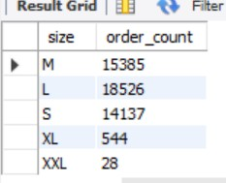
4.Identify the most common pizza size ordered

Slide 9


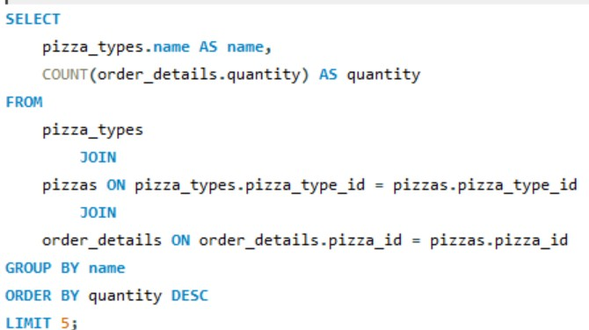
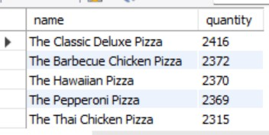
5.List the top 5 most ordered pizzas along with their
quantityred

Slide 10


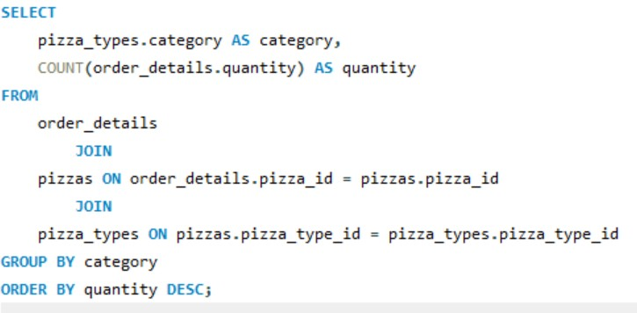
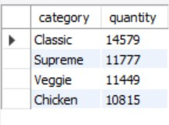
6.Join the necessary table to find the total quantity of each
pizza category ordered

Slide 11

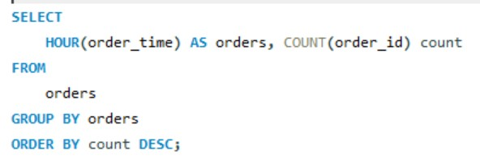
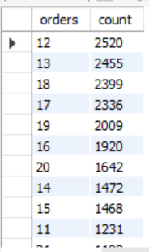

7.Determine the distribution of orders by hour of the day

Slide 12

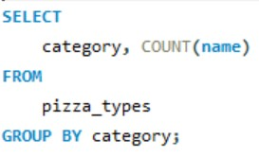
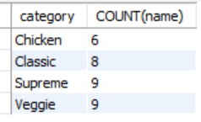
8.Join the relevent table to find the category-wise distribution
of pizzas

Slide 13
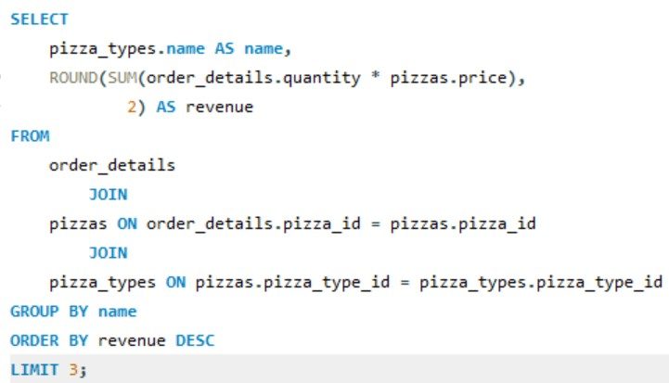
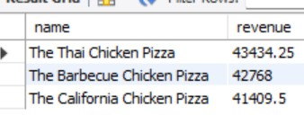
9.Determine the 3 most ordered pizza based on the revenue

Slide 14

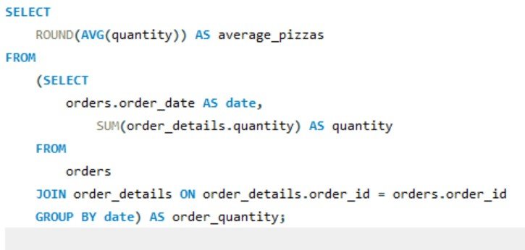
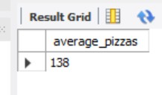

10. Group the orders by date and caliculate the avarage
number of pizzas ordered per day

Slide 15

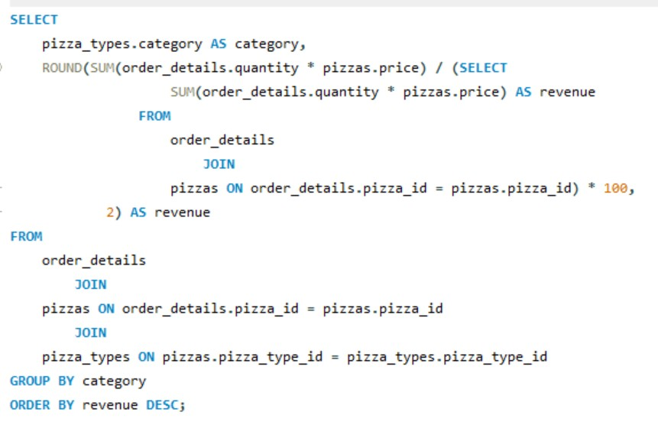
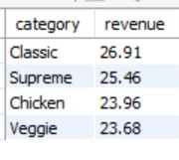
11.Calculate the percentage contribution of each pizza type to
total revenue

Slide 16
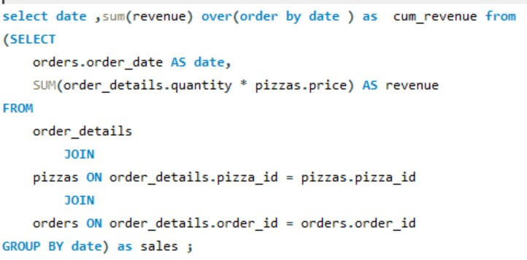
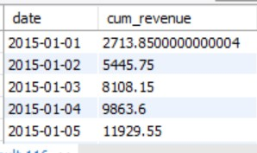

12.Analyze the cumulative revenue generated over time

Slide 17

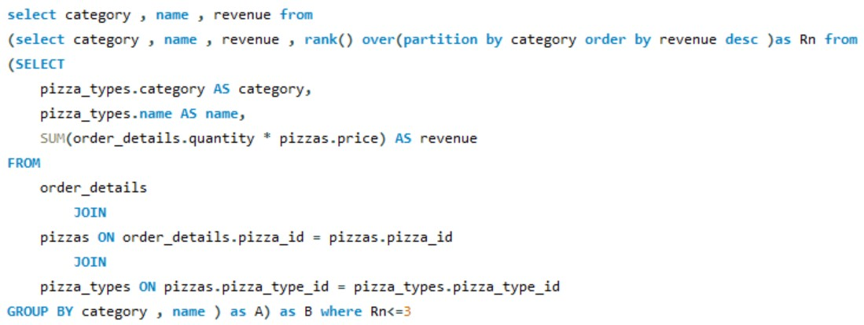
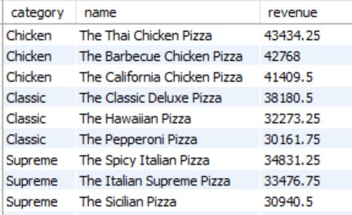
13.determine the top 3 most ordered pizza types based on
revenue for each pizza category

Slide 18




PIZZA PARTY!

